Slide 1


Autonomous Agricultural Rover
Precision Weed Detection & Laser Elimination System

Slide 2

System Mission & Vision
The system is an autonomous solution designed to revolutionize modern farming by replacing chemical-heavy weeding with precision engineering.
Navigation: Line-following for precise paths.
Perception: Vision-based weed identification.
Treatment: Targeted elimination via laser modules.
Safety: Integrated obstacle avoidance protocols.

Slide 3

Distributed Control System
High-Level Brain (RPi 5)
Real-Time Muscle (ESP32)
Responsible for computationally intensive tasks including AI-driven vision processing, weed classification, and high-level decision logic.
Handles real-time sensor polling and motor control where latency must be minimized to ensure mechanical stability.
•
YOLO-based Detection
•
PWM Motor Driving
•
Relay Actuation (Laser)
•
Ultrasonic & Line Polling
•
UART Instruction Master
•
Safety-Interlocks

Slide 4
System Bill of Materials
Category | Component | Core Functionality
Controllers | RPi 5 & ESP32 | High-level AI + Low-level Real-time Control
Actuation | TT Motors & SG90 Servo | Locomotion and directional sensor scanning
Vision | RPi Camera Module | Ground image capture for weed identification
Sensing | HC-SR04 & TCRT5000 | Obstacle detection & Line following tracking
Power | LM2596 & L298N | Voltage regulation & Power motor driving

Slide 5

Operational Workflow
route
Path Follow
Rover tracks line via TCRT5000
sensors
Obstacle Scan
Ultrasonic checks for path blocks
photo_camera
Image Capture
RPi camera captures ground data
psychology
AI Analysis
Vision model identifies weeds
flash_on
Elimination
Laser activates via relay switch

Slide 6
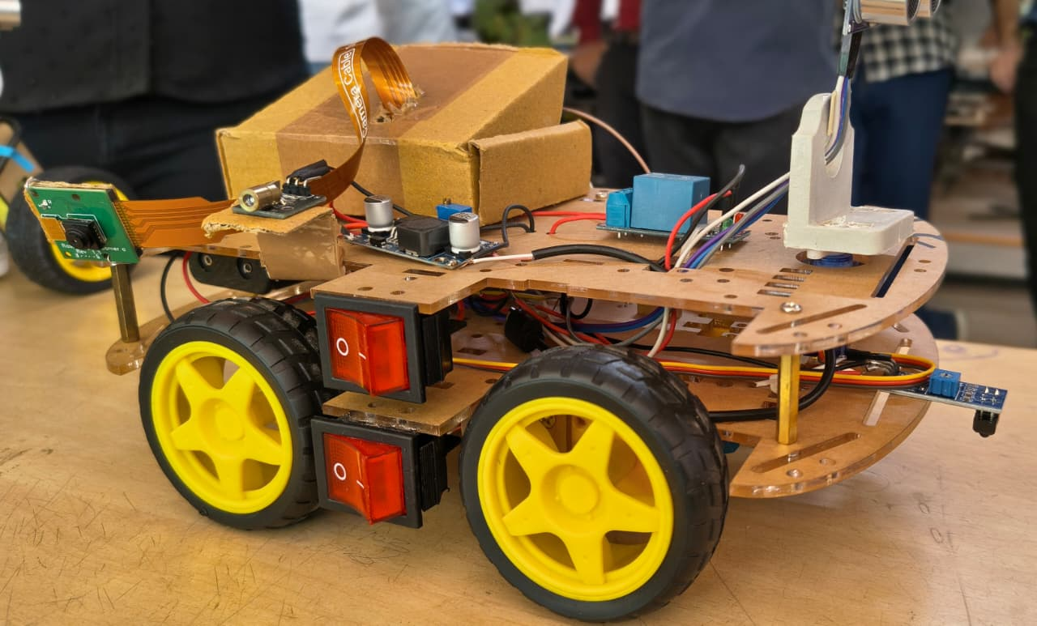
Precision Line Following
TCRT5000 Reflective Logic
The navigation relies on infrared reflection intensity to distinguish between the path and field surface.
White Surface: High reflection → Low analog value.
Black Path: Low reflection → High analog value.
Correction: Threshold-based PWM adjustment for smooth steering.

Slide 7







Safety & Obstacle Avoidance
Distance Calc
Servo Scan
E-Stop
Uses HC-SR04 ultrasonic pulses to measure gap.
When blocked, SG90 servo rotates sensor 180° to find clear path.
Automatic motor cutoff if obstacle is within 15cm threshold.

Slide 8
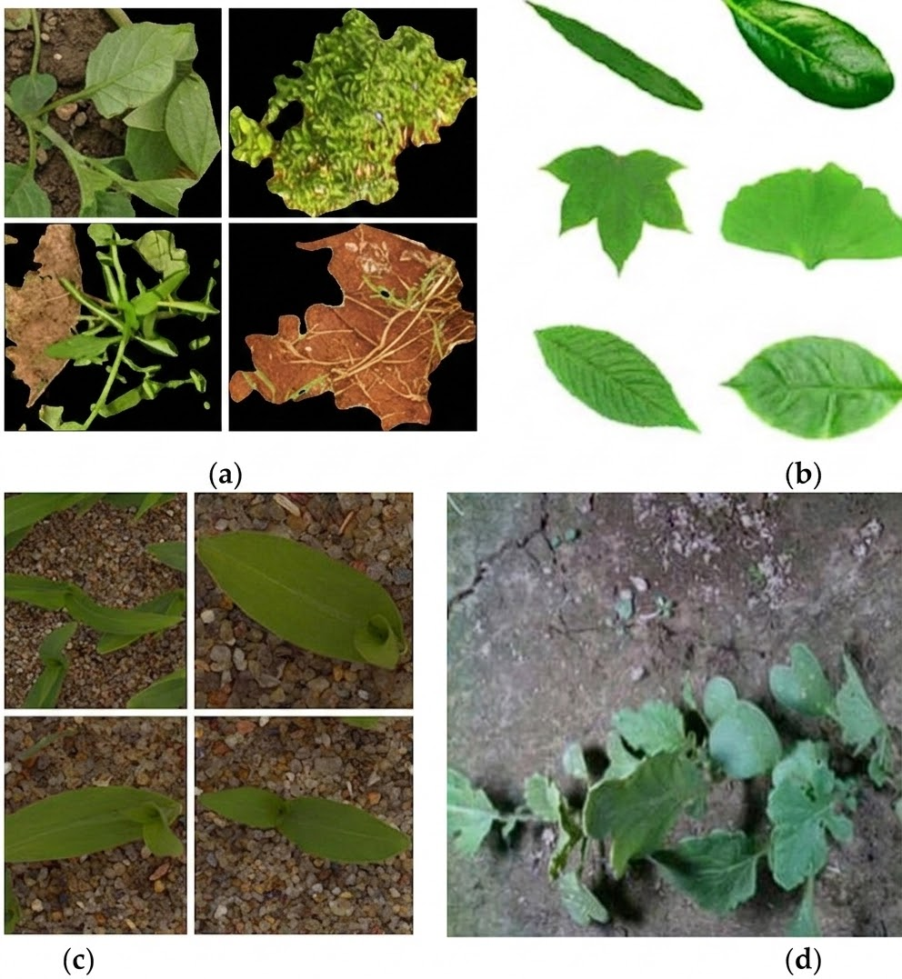
AI Vision Intelligence
Automated Classification
The Raspberry Pi 5 runs a localized YOLO (You Only Look Once) model for real-time inference. By processing high-resolution frames, it distinguishes between crop stems and invasive weed growth patterns.
(a) (b)
Once detected, the coordinates are used to trigger the treatment relay with sub-second latency.
(c) (d)

Slide 9
Precision Elimination System
Targeted Laser Therapy
94%
Using the KY-008 Laser Module coupled with a 5V Relay, the system provides a chemical-free alternative to traditional herbicides.
Switching: Isolated via relay to protect RPi GPIO.
Intensity: Concentrated thermal energy to neutralize weed growth cells.
Targeting Accuracy
Safety: Only activates when rover is stationary at a detected weed.

Slide 10

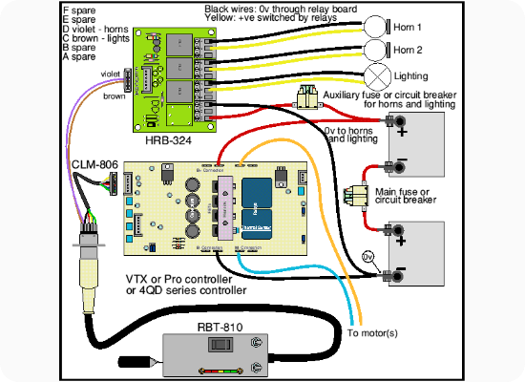
Motor Drive Implementation
Control of the 4x TT Motors is managed through the L298N Dual H-Bridge driver, allowing for differential steering.
Forward: All IN pins configured for unidirectional rotation.
Turn: Reversed polarity on left or right motor banks.
PWM Speed: Pulse-width modulation on ENA/ENB pins for variable torque.

Slide 11



Inter-Processor Communication
Commands (RPi → ESP32): Motion vectors, stop signals, and treatment coordinates.
UART Protocol
Distributed intelligence via Serial communication (3.3V logic).
Status (ESP32 → RPi): Obstacle proximity warnings, path-loss alerts, and battery level telemetry.

Slide 12
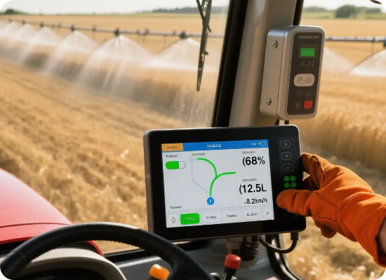
Power Management Strategy
Dual-Rail Regulation
To avoid current starvation during motor spikes, the system employs a split power strategy.
Motor Rail (7.4V): Direct battery feed to L298N driver for TT motors.
Logic Rail (5.1V): Regulated via LM2596 buck converter for RPi 5 and SG90 servo.
Stability: 1000µF capacitor buffer to prevent brownouts.

Slide 13






Engineering For Stability
Noise Handling
Common Ground
Thermal Control
100nF decoupling capacitors across TT motor terminals to suppress EMI.
Unified ground reference across RPi, ESP32, and Driver for signal integrity.
Heatsink integration on LM2596 to prevent thermal throttling during operation.

Slide 14

Strategic Scaling & Future
Current Advantages
Next Milestones
•
Zero herbicide residue.
•
GPS-based waypoints.
•
Low-cost distributed hardware.
•
Solar charging integration.
•
Real-time automated intervention.
•
Robotic arm for physical weeding.

Slide 15
Thank You
IU2341230380 - Abhimanyu Singh Rajawat
IU2341230385 - Shiven Choksi
IU2341230404 - Nikhil Solanki
IU2341230408 - Trishta Soam
IU2341230450 - Yogesh Tiwari

